Slide 1
Network Protocols & Security
[22EC2210]
CO-2
IP Addressing

Slide 2
AGENDA
IP Address​es
IPv4 Address
Address Space
Notations
Classful Addressing
Casting
Classless Addressing
IPv6
Addressing Methods

Slide 3
IP ADDRESSES
An IP address is a numeric identifier assigned to each machine on an IP network.
It designates the specific location of a device on the network.
An IP address is a software address, not a hardware address—the latter is hard-coded on a network interface card (NIC)
IP addressing was designed to allow hosts on one network to communicate with a host on a different network regardless of the type of LANs the hosts are participating in.
Versions: IPv4 and IPv6

Slide 4
AIM OF THE SESSION
The aim of studying IP addressing is to understand the fundamental concepts, principles, and practices related to the allocation and management of IP addresses in computer networks. This knowledge enables individuals to effectively design, implement, and troubleshoot IP-based networks, ensuring efficient and reliable communication between devices.
INSTRUCTIONAL OBJECTIVES
Understand the structure and format of IP addresses: Students should be able to explain the binary and decimal representation of IP addresses, including the distinction between IPv4 and IPv6 addresses. They should understand the concept of network and host portions within an IP address.
Learn IP address classes and address space allocation: Students should comprehend the different classes of IPv4 addresses (Class A, B, C, D, and E) and their corresponding address ranges. They should understand how address space is allocated to organizations and the impact of address classes on network design and address allocation.
LEARNING OUTCOMES
By the end of the module on IP addressing, students will be able to:
Describe the structure and format of IP addresses, differentiating between IPv4 and IPv6.
Classify IP addresses into appropriate address classes and identify the address ranges for each class.
Apply appropriate IP address assignment methods based on specific network requirements.
Troubleshoot IP addressing issues, such as address conflicts and subnet configuration problems.

Slide 5
1. Address SPACE
The total number of addresses used by the protocol. If a protocol uses N bits to define an address, the address space is 2^{N} because each bit can have two different values (0 or 1) and N bits can have 2^{N} values.
The address space of IPv4 is 2³² or 4,294,967,296.
The address space of IPv6 is 2¹²⁸ or 40,282,366,920,938,463,463,374,607,431,768,211,456.

Slide 6
IPv4 ADDRESSES
An IPv4 address is a 32-bit address that uniquely and universally defines the connection of a device (for example, a computer or a router) to the Internet..
Topics discussed in this section:
1. Address Space
2. Notations
3. Classful Addressing
4. Classless Addressing

Slide 7
2. NOTATIONS
There are two prevalent notations to show an IPv4 address:
Dotted-Decimal notation
Binary notation
Hexadecimal notation
2. a. Dotted-Decimal Notation
To make the IPv4 address more compact and easier to read, Internet addresses are usually written in decimal form with a decimal point (dot) separating the bytes.
The following is the dotted-decimal notation of the above address: 117.149.29.2

Slide 8
2. NOTATIONS (contd…)
2.b. Binary notation
In binary notation, the IPv4 address is displayed as 32 bits.
Each octet is often referred to as a byte.
it is common to hear an IPv4 address referred to as a 32-bit address or a 4-byte address.
The following is an example of an IPv4 address in binary notation

Slide 9
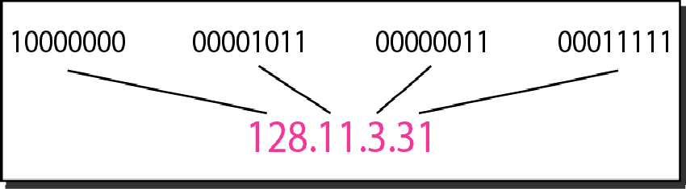
Dotted-decimal notation and binary notation for an IPv4 address

Slide 10
2. NOTATIONS (contd…)
2.c. Hexadecimal notation
In binary notation, the IPv4 address is displayed 8 hexadecimal digits.
Example: 10000001 00001011 00001011 11101111
Hexadecimal notation is: 810B0BEF₁₆

Slide 11
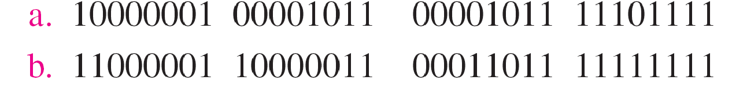
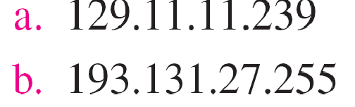
Example
Change the following IPv4 addresses from binary notation to dotted-decimal notation.
Solution
We replace each group of 8 bits with its equivalent decimal number and add dots for separation

Slide 12
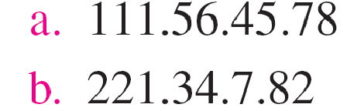
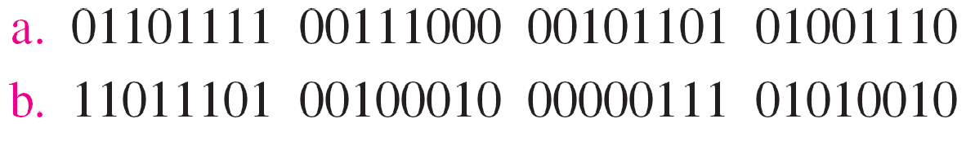
Example
Change the following IPv4 addresses from dotted-decimal notation to binary notation.
Solution
We replace each decimal number with its binary equivalent

Slide 13
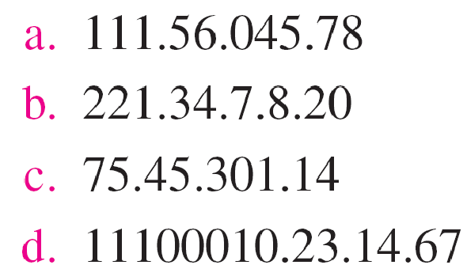
Example
Find the error, if any, in the following IPv4 addresses.
Solution
There must be no leading zero (045).
There can be no more than four numbers.
Each number needs to be less than or equal to 255.
A mixture of binary notation and dotted-decimal notation is not allowed.

Slide 14
3. Classful addressing
IPv4 addressing, at its inception, used the concept of classes.
The address space is divided into five classes: A, B, C, D, and E. Each class occupies some part of the address space
We can find the class of an address when given the address in binary notation or dotted- decimal notation.
If the address is given in binary notation, the first few bits can immediately tell us the class of the address.
If the address is given in decimal-dotted notation, the first byte defines the class.

Slide 15
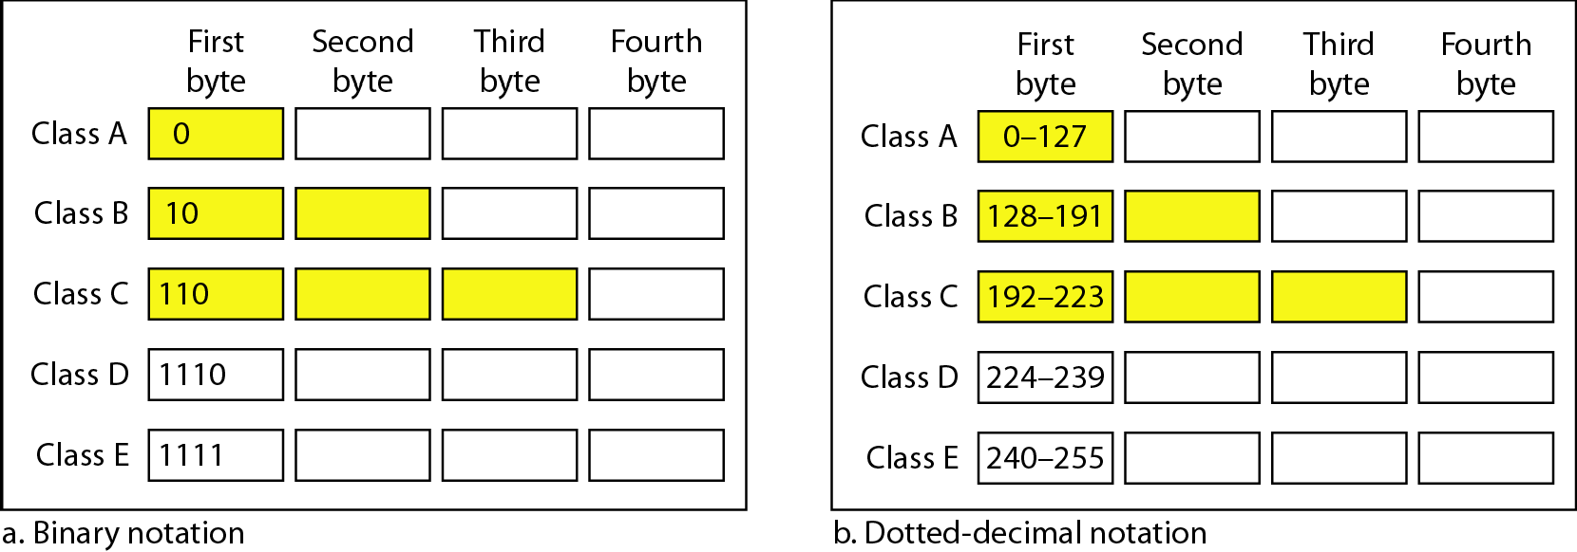
Finding the classes in binary and dotted-decimal notation
Classful addressing contd…
Classful addressing

Slide 16
Classful addressing contd…
Netid and Hostid
In classful addressing, an IP address in class A, B, or C is divided into netid and hostid.
These parts are of varying lengths, depending on the class of the address.
The concept does not apply to classes D and E.
In class A, one byte defines the netid and three bytes define the hostid. In class B, two bytes define the netid and two bytes define the hostid. In class C, three bytes define the netid and one byte defines the hostid.

Slide 17
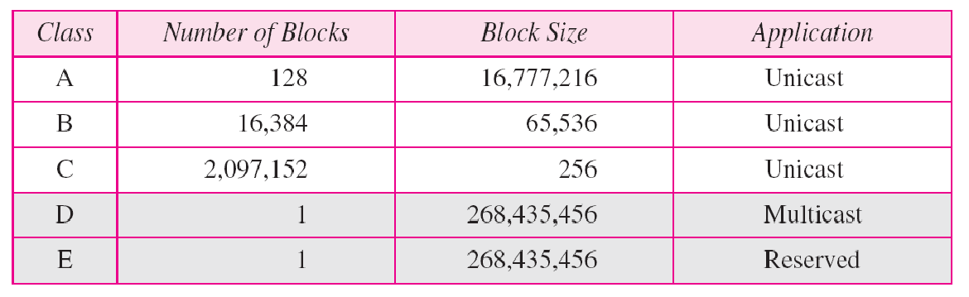
Number of blocks and block size in classful IPv4 addressing
Classful addressing contd…

Slide 18
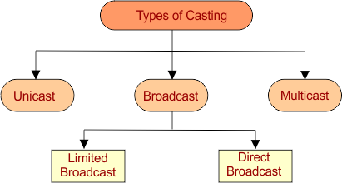
Casting and its types
Casting : Casting is a method of transferring a packet to various hosts simultaneously by using an IP address
Types of Casting

Slide 19
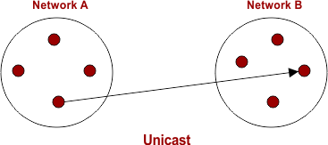
Casting and its types contd…
1. Unicast
Transmitting a packet from one source node to one destination node is called as unicast.
We can say, it is a one to one transmission.

Slide 20
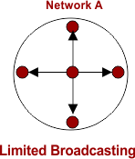
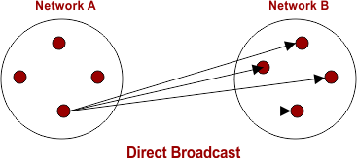
Casting and its types contd…
2. Broadcast
In Broadcasting, Packet is send to all residing host in the same or different network, depending on its types.
It is a one to all transmission.
Broadcasting is of two types [Limited Broadcast, Direct Broadcast]

Slide 21
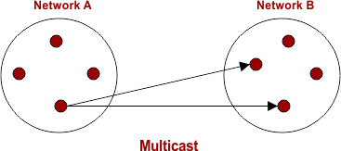
Casting and its types contd…
3. Multicast
Transmitting data packet from one source Node to a particular group of Nodes is known as Multicast.
It is also an example of one to many transmission.

Slide 22
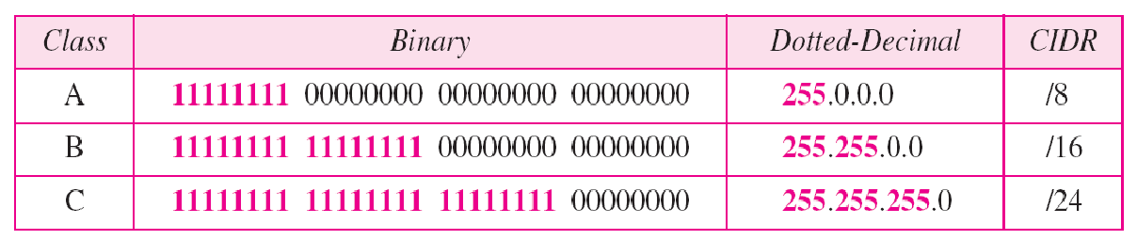
Classful addressing contd…
Mask
Although the length of the netid and hostid (in bits) is predetermined in classful addressing, we can also use a mask (also called the default mask)
32-bit number made of contiguous 1’s followed by contiguous 0’s. The masks for classes A, B, and C. The concept does not apply to classes D and E.
The mask can help us to find the netid and the hostid.

Slide 23
Example
Find the class of each address.
a. 00000001 00001011 00001011 11101111
b. 11000001 10000011 00011011 11111111
c. 14.23.120.8
d. 252.5.15.111
Solution
The first bit is 0. This is a class A address.
The first 2 bits are 1; the third bit is 0. This is a class C address.
The first byte is 14; the class is A.
The first byte is 252; the class is E.

Slide 24
4. Classless addressing
To overcome address depletion and give more organizations access to the Internet, classless addressing was designed and implemented.
Here are no classes, but the addresses are still granted in blocks.
Address Blocks
In classless addressing, when an entity, small or large, needs to be connected to the Internet, it is granted a block (range) of addresses.
The size of the block (the number of addresses) varies based on the nature and size of the entity.

Slide 25
Classless addressing contd…
Restriction: To simplify the handling of addresses, the Internet authorities impose three restrictions on classless address blocks:
The addresses in a block must be contiguous, one after another.
The number of addresses in a block must be a power of 2 (I, 2, 4, 8, ... ).
The first address must be evenly divisible by the number of addresses.

Slide 26
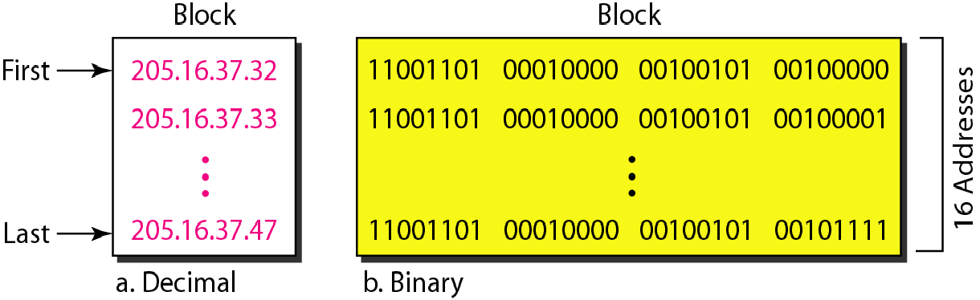
A block of 16 addresses granted to a small organization
Classless addressing contd…

Slide 27
Classless addressing contd…
Mask
A better way to define a block of addresses is to select any address in the block and the mask.
A mask is a 32-bit number in which the n leftmost bits are I’s and the 32 - n rightmost bits are 0’s.
However, in classless addressing the mask for a block can take any value from 0 to 32. It is very convenient to give just the value of n preceded by a slash (CIDR notation)
/n [denotes the prefix length]
/(n-32) [denotes the suffix length]

Slide 28
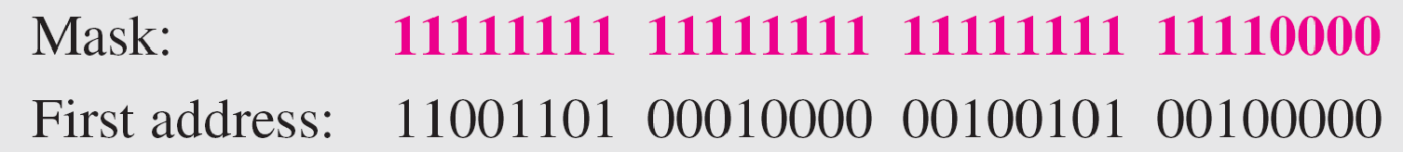
Example
A block of addresses is granted to a small organization. We know that one of the addresses is 205.16.37.39/28. What is the first address in the block?
Solution
The binary representation of the given address is
11001101 00010000 00100101 00100111
If we set 32−28 rightmost bits to 0, we get
11001101 00010000 00100101 0010000
or 205.16.37.32.

Slide 29
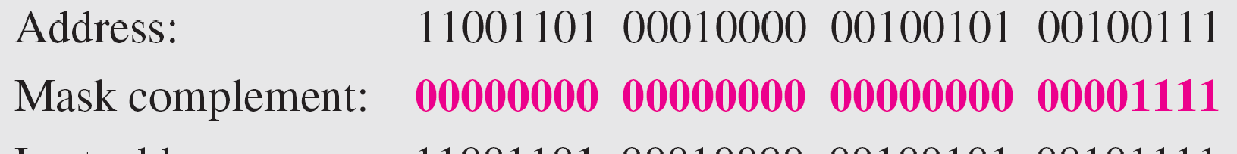
Example
Find the last address for the block
Solution
The binary representation of the given address is
11001101 00010000 00100101 00100111
If we set 32 − 28 rightmost bits to 1, we get
11001101 00010000 00100101 00101111
or 205.16.37.47

Slide 30
Internet Protocol version 6 (IPv6)
IPv6 was developed by Internet Engineering Task Force (IETF) to deal with the problem of IPv4 exhaustion.
IPv6 is a 128-bits address having an address space of 2¹²⁸, which is way bigger than IPv4.
IPv6 use Hexa-Decimal format separated by colon (:) .

Slide 31
Internet Protocol version 6 (IPv6)
Components in Address format :
There are 8 groups and each group represents 2 Bytes (16-bits).
Each Hex-Digit is of 4 bits (1 nibble)
Delimiter used – colon (:)

Slide 32
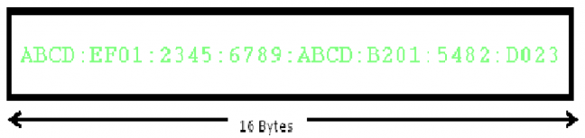
Internet Protocol version 6 (IPv6)
Components in Address format :
There are 8 groups and each group represents 2 Bytes (16-bits).
Each Hex-Digit is of 4 bits (1 nibble)
Delimiter used – colon (:)

Slide 33
Internet Protocol version 6 (IPv6)
Need for IPv6:
Large address space
Better header format
New options
Allowance for extension
Support for resource allocation
Support for more security

Slide 34
Addressing methods
In IPv6 representation, we have three addressing methods :
Unicast
Multicast
Anycast
Unicast Address
Unicast Address identifies a single network interface. A packet sent to a unicast address is delivered to the interface identified by that address.

Slide 35
Addressing methods
Multicast Address
Multicast Address is used by multiple hosts, called as groups, acquires a multicast destination address. These hosts need not be geographically together. If any packet is sent to this multicast address, it will be distributed to all interfaces corresponding to that multicast address. And every node is configured in the same way. In simple words, one data packet is sent to multiple destinations simultaneously.
Anycast Address
Anycast Address is assigned to a group of interfaces. Any packet sent to an anycast address will be delivered to only one member interface (mostly nearest host possible).

Slide 36
SELF-ASSESSMENT QUESTIONS
In a block of addresses, we know IP address of one host is 25.34.12.56/16. What is the first address (network address) and the last address (limited broadcast address) in this block?
Find the block if one of the addresses is 190.87.140.202/29
In a network the address of one computer is 201.78.24.56 and the address of another computer is 201.78.120. 202. How many addresses are in between?
What is the main difference between IPv4 and IPv6?
What are the key advantages of IPv6 over IPv4?

Slide 37
REFERENCES FOR FURTHER LEARNING OF THE SESSION
Reference Books:
1. Data Communications and Networking, Behrouz A. Forouzan, 4th Edition, McGraw Hill.
2. Computer Networks, Tanenbaum, 6th Edition, Pearson.
Sites and Web links:
CISCO Academy
NPTEL, Computer Networks and Internet Protocols, Prof. Soumya Kanti Ghosh, Prof. Sandip Chakraborty IIT Kharagpur. (https://nptel.ac.in/courses/106105183)

